Slide 1
Micro-Credit Defaulter Project

Slide 2
Exploratory Data Analysis

Slide 3
Steps
Importing the libraries needed for my project
Loading the dataset/Creating my dataframe
Checking the head of the dataset(first five rows)
Checking the shape of the dataset
Checking the datatypes
Checking for null values if any
These data analysis steps help us to get an overview of our dataset and also help us in our preprocessing of our data.

Slide 4
Preprocessing of the data

Slide 5
Steps and Description
Dropping some irrelevant columns from the data like ‘Unnamed:0’,’msisdn’,’aon’.(msisdn-phone numbers of the users, aon-age on cellular network in days)
Dropping again two columns ‘pcircle’ and ‘pdate’ as pcircle is telling a specific telecom circle and pdate is about dates, so these two columns are not playing any significant role.
Now I will visualize my data using heatmap,I will see the correlation between the data. The screenshot of the heatmap is attached below.

Slide 6
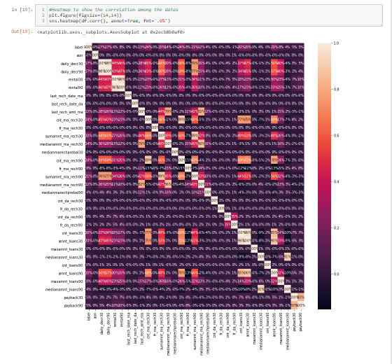
Bc ssx nMx,m,x,xmaxaxnk

Slide 7
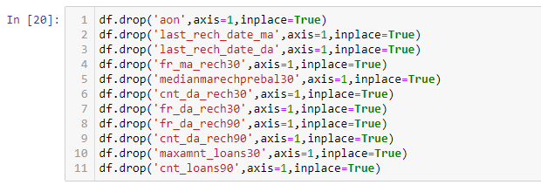
Observation
From the heatmap, it is seen that there are some columns which are 0% correlated with the target variable ‘label’.
So I think those columns which are not correlated with the target variable will not give any fruitful result.
That’s why I have dropped those columns from the dataset.

Slide 8
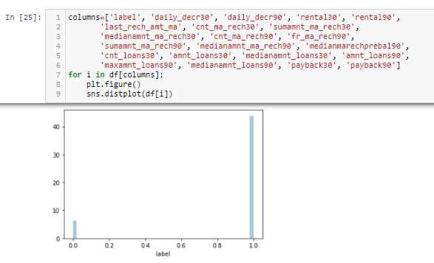
Some more preprocessing steps
Statistical summary of the dataset is studied.
Some visualization is done using distribution plots where we can see how our data look like. I have attached some of the screenshots.

Slide 9
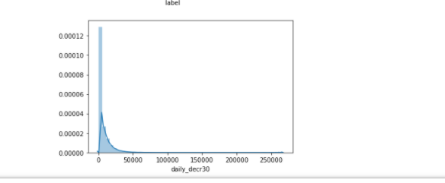
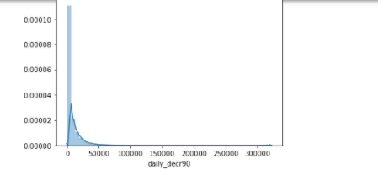
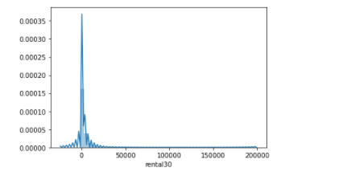

Slide 10
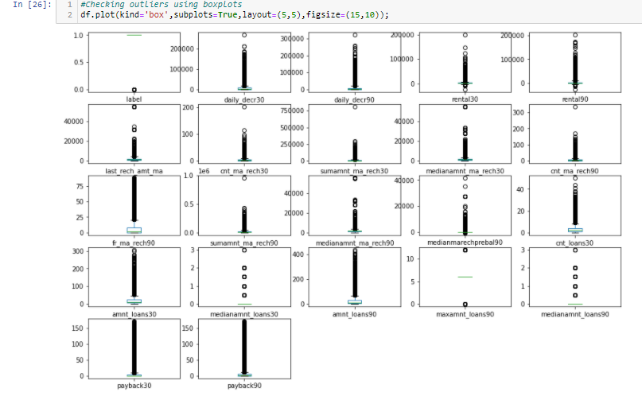
Now, I will see if any outliers are present in the data using boxplots. If there are outliers, I will use zscore method to remove it.By removing outliers ,we can clean our data.
Outliers are present which can be seen from the plots. So we have to remove it.

Slide 11
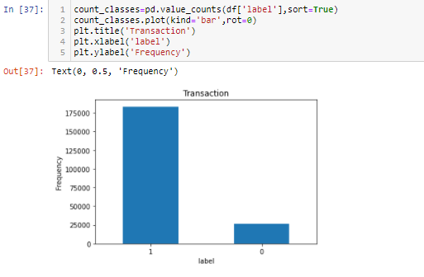
Preprocessing (contd…)
Next, skewness in data is checked and is removed using power transform function.
Then the target variable ‘label’ is visualized using barplot.I am attaching the snapshot of it where we can clearly see that the dataset is imbalanced.

Slide 12
Preprocessing (contd…)
I am using RandomOverSampler to balance my dataset.
Then scaling the data to a standard form using StandardScaler.
Now my data is clean and ready for model building.

Slide 13
Model building

Slide 14
Explanation
I have used Balanced Random Forest Classifier to build the model using imbalanced dataset because this algorithm can be easily used on imbalanced data. The accuracy that I have achieved after hyperparameter tuning(RandomizedSearchCV) is 84% anf f1-score for 0 is 57% and for 1 it is 90%.I am not satisfied with the fi-score and so tried to build the model using another classifier.
Next,I have used Decision Tree Classifier to build the model using balanced set of data which is achieved by RandomOverSampler method. Here the accuracy after hyperparameter tuning (GridSearchCV) is 94% and f1-score for 0 is 95% and for 1 is 94% which is quite satisfactory.

